Slide 1


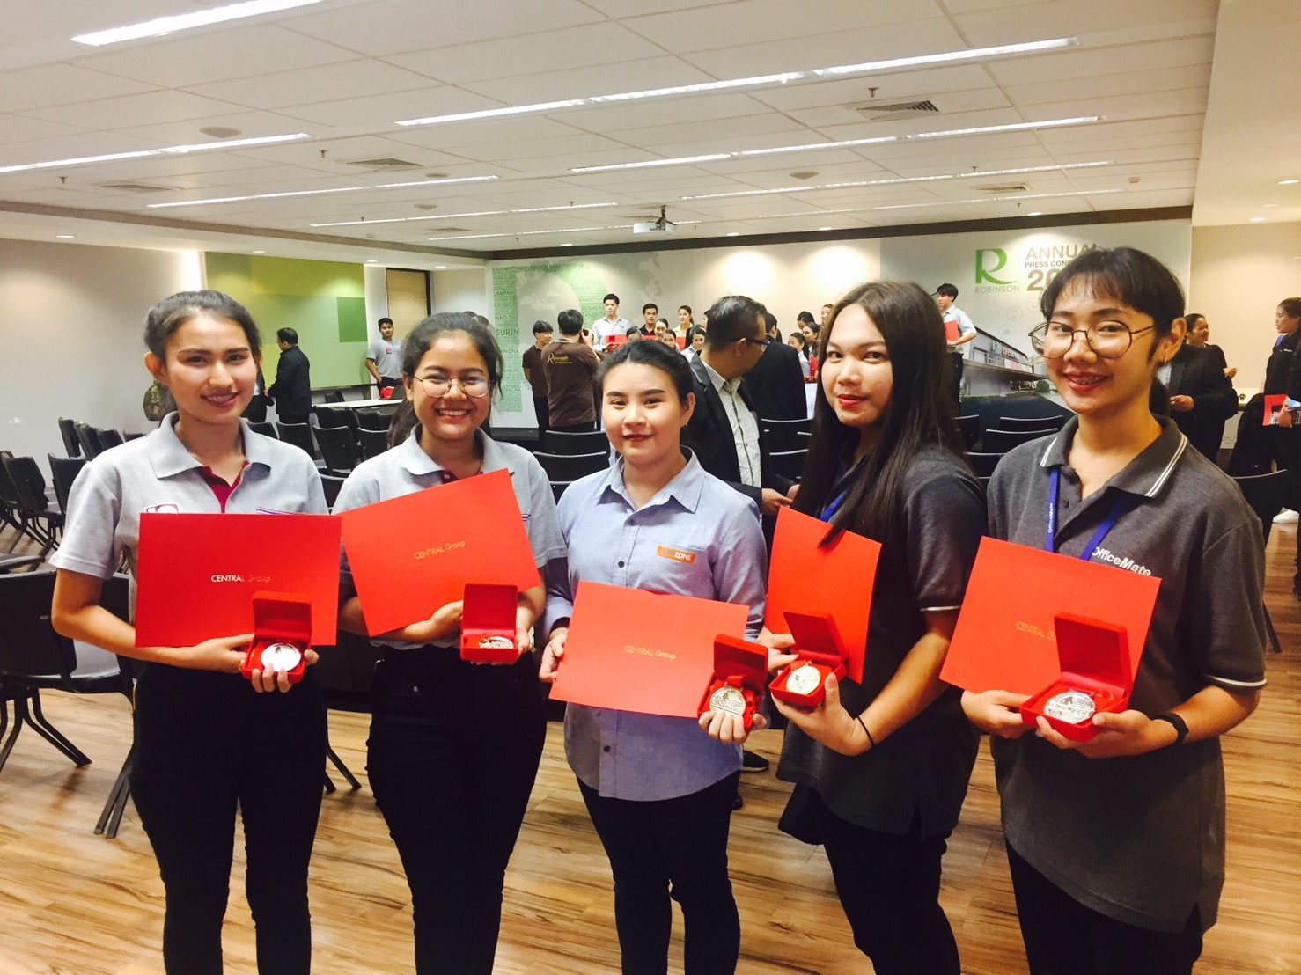
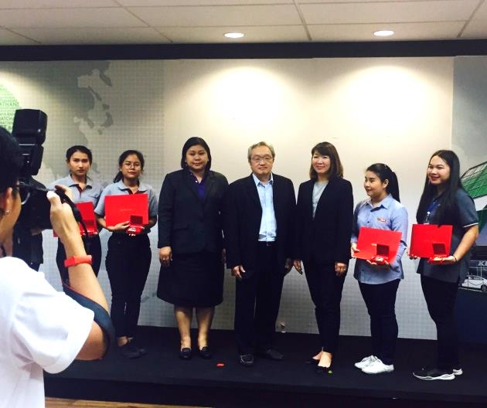
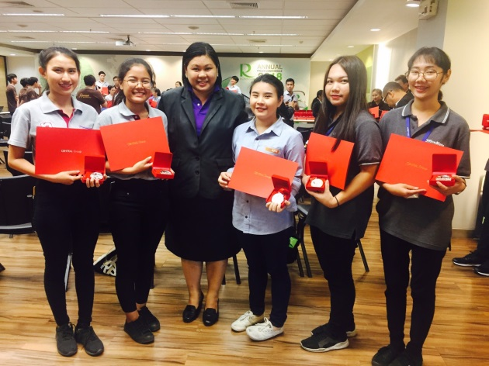





College of Logistics and Supply Chain
Central Group Presented an Academy Honorary Award to the College of Logistics and Supply Chain Students, Suan Sunandha Rajabhat University.
The College of Logistics and Supply Chain Students were received an Academy Honorary Award from Central Group in the Dual Degree Program Scholarship Grant at Head office, Robinson Department Store. Five outstanding students: Goerlakot Chuaysang in First Class Honor, Kunlaya Mongkolsutr, Haruetai Thongnarin, Natchanok Techaritpitak, and Sansanee Aiamprasert, the distinction recognizes their academic excellence and exemplary professional practice.
@hzj9893
www.cls.ssru.ac.th
วิทยาลัยโลจิสติกส์และซัพพลายเชน
มหาวิทยาลัยราชภัฏสวนสุนันทา
cls.ssru@gmail.com
034964917

