Slide 1


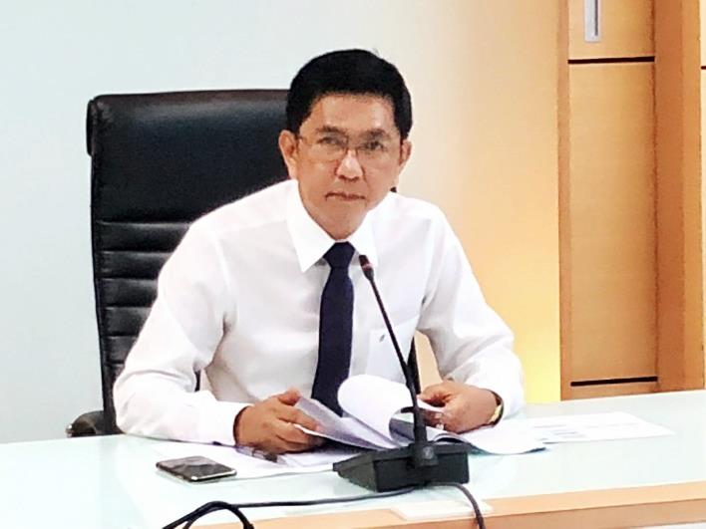
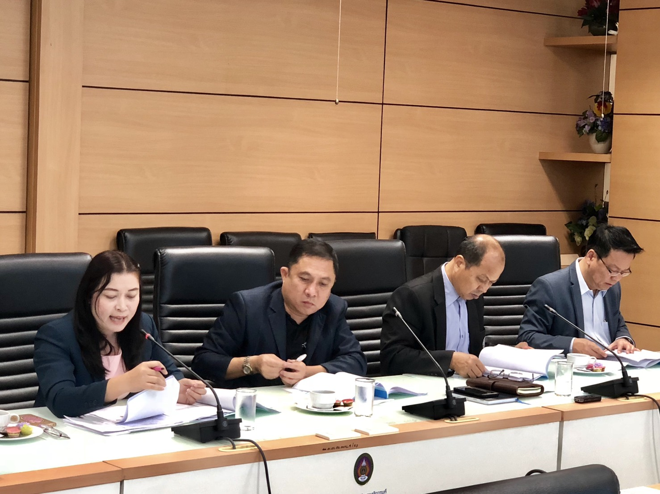
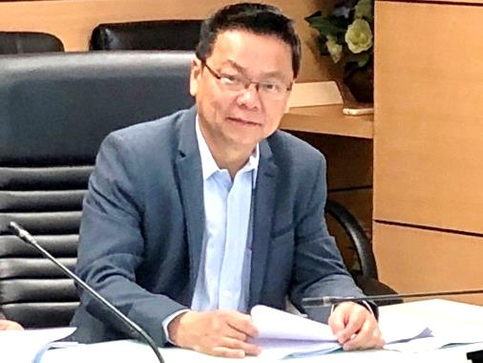
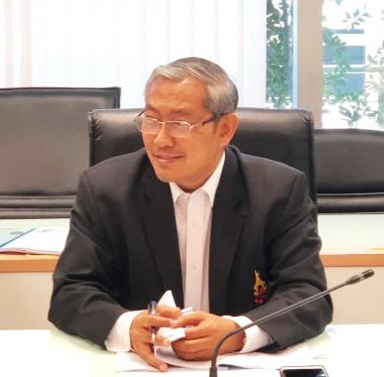
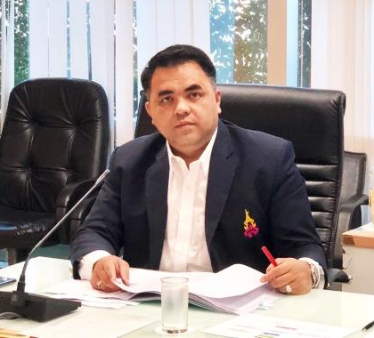
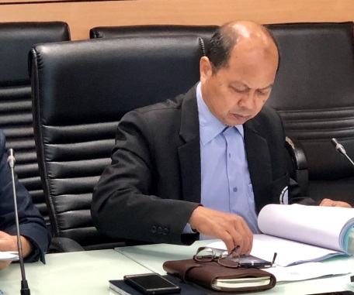
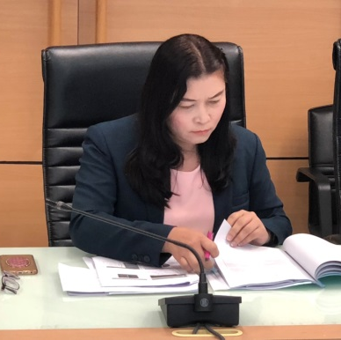
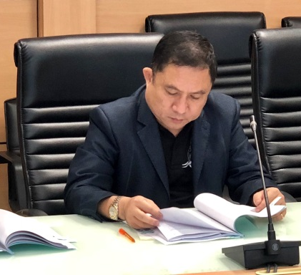
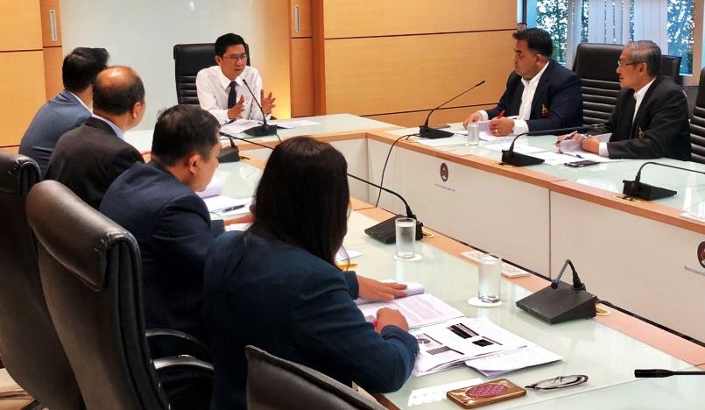





College of Logistics and Supply Chain
The 6th/2018 College of Logistics and Management’s Board of Committee Meeting
On 26th September 2018, Assoc. Prof. Dr.Luedech Girdwichai is the Chairman of the 6th/2018 College of Logistics and Management’s Board of Committee Meeting at the President Office meeting room.
@hzj9893
www.cls.ssru.ac.th
College of Logistics and Supply Chain
SUAN SUNANDHA RAJABHAT UNIVERSITY
cls.ssru@gmail.com
034964917

