Slide 1


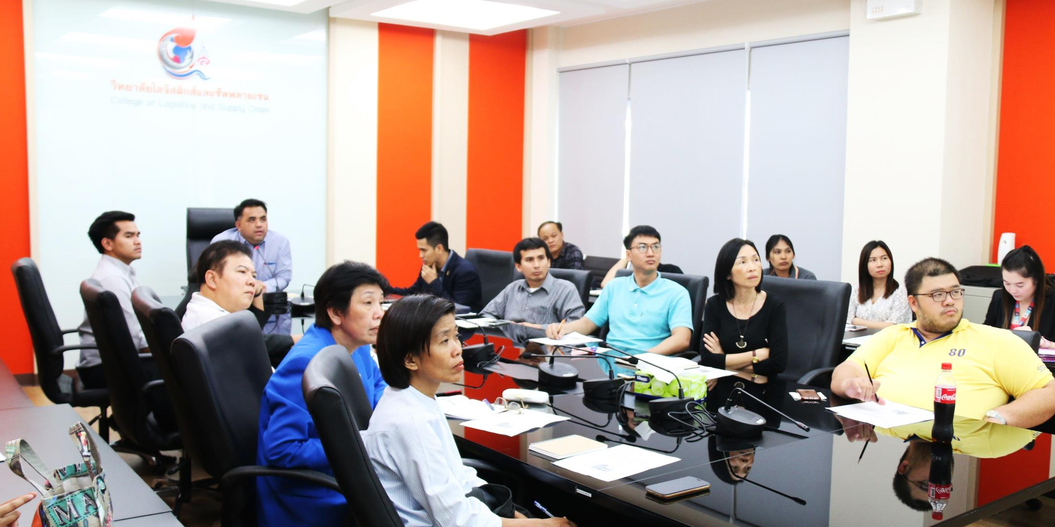
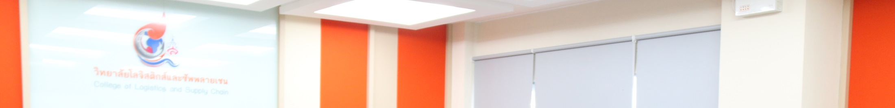

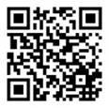



College of Logistics and Supply Chain
Admission Meeting for 2019 Academic Year
On September 21, 2018 Assist Prof Dr. Komson Sommanawat, the Dean of College of Logistics and Supply Chain was a chairman of Academic year 2019 admission meeting held at Logistics conference room, building 2, the 1st floor, Nakornpathom education centre.
@hzj9893
www.cls.ssru.ac.th
College of Logistics and Supply Chain
Suan Sunandha Rajabhat University
cls.ssru@gmail.com
034964917

